Slide 1
SCSIT
IV Semester
Databases
Exc. 1
Introduction to database Entity

Slide 2
What shall we learn?
Entities and ER Diagrams
Database Relational model
SQL (Structured Query Language)

Slide 3
How shall we learn?
Classes
Homework: individual works
Projects: individual or team work ?!?
Will agree after MidTerm

Slide 4
Needed software
MS Word
(or another Text editor)
ERD tool
(MS Visio (obsolete), Diagrams.net (Draw.io))
SQL Server
Microsoft® SQL Server® 2019 Express
SQL Server Management Studio (SSMS)

Slide 5
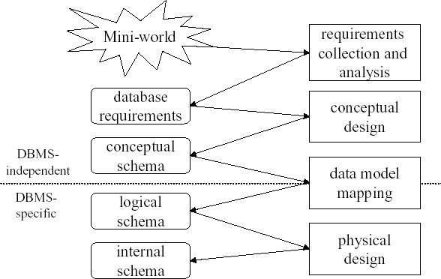
Data – Modeling procces
Notes:
It’s basically the step-by-step process of designing a database. Think of it like building a house: you start with ideas, then make blueprints, and finally construct the actual building. The diagram shows how database design moves from abstract ideas to a working system.
Mini-world → This is the real-world situation you want to capture (like a shop, school, or hospital). Requirements collection and analysis → You talk to people and figure out what information the database needs (like customer names, products, grades).
Database requirements → A clear list of what the database must store and do.
Conceptual design → You sketch out the big picture, often with diagrams (like ER diagrams). This creates the conceptual schema.
Data model mapping → You translate that big-picture design into a more technical format that matches a specific database system. This gives you the logical schema.
Physical design → You decide how the data will actually be stored on the computer (indexes, storage, performance tweaks). This becomes the internal schema.

Slide 6
Entity – Relationship model: Е-R model
Model for conceptual designing
ERD tools
(Diagrams.net, Lucidchart, Moqups, SqlDBM, Erwin, Data Architect, Oracle designer, MS Visio)
Result: ER Schema/ ER diagram (graphical representation of the conceptual schema)

Slide 7
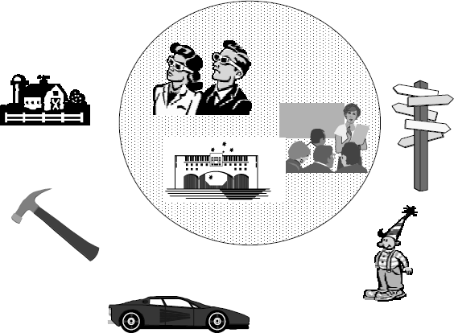
Database modeling
Collection of Entities and entity types
Relationships between entities
Constraints
Entities and Relationships are part of, so called mini world,
i.e. part of the real world that is presented with them

Slide 8
What is Entity?
An entity is as a thing which is recognized as being capable for independent existence and which can be uniquely identified.
Ex.
Particular person, company, event
An entity may be a:
physical object such as a house or a car,
event such as a house sale or a car service, or
concept such as a customer transaction, school, order.
Entities can be thought of as nouns.
Ex. a computer, an employee, a song, a mathematical theorem.

Slide 9
Entity - type
An entity, is an instance of a given entity-type.
Entity -type is a set of entities that share common characteristics. Ex:
Set of many people, companies, trees, festivals, bank transactions, countries etc.
Note: Because the term entity-type is somewhat cumbersome, most people tend to use the term entity as a synonym for this term.

Slide 10
Entity examples
Task 1:
Write 3 types of entities.
Physical objects
Client
Store
Employee
Video Tape
Abstract
School
Subject
Event
Exam
Rent-a-tape
Purchase

Slide 11
Entity attributes
One entity is represented with set of attributes. Attributes are descriptive characteristics that are part of all entity members. They can have same, similar or different values.
Ex:
user = (user_name, social_number, street, city)
account = (account_no, amount)
Attribute Domain is set of available values for the attribute
Ex:
Attribute Gender € {Male, Female}
amount is number from (- infinity, +infinity)
Instance = one value from the domain
11

Slide 12
Entity attributes
By value
single-valued = one value attribute
multi-valued = attribute with more than one value
Course name Lectures in one course
Ex.
2. By complicity
Simple
Composite (values from different types)
Ex.
ID number Address (Street, City, Post Code)
3. By compulsority
Required
Not required
12

Slide 13
Task 2:
Write at least 5 attributes for every entity you’ve wrote in Task 1. Try to define some composite attribute.
Ex.
Entity: Client
Attributes:
name, PID
Address (street, no) City
Gender
Date_of_membership Birthdate member_card_ID Phone
email
13

Slide 14
Entity instances
□ Entity instance is one representative from the entity type that has its own values for very entity attribute.
Ex.
For Entity Employee (Name, Title, Salary), One possible instance is
Employee (“Aleksandar”, ”CEO”, 30000)
or
Employee (“Marija”, ”Secretary”, 12000)
or
Employee (“Peter”, ” ”, 12000)
14

Slide 15
Ass. 3:
Write 3 instances for every of your entities.
15

Slide 16
Uniquely identifying attribute
One or more entity attributes can identify an entity instance i.e. these attributes have different values in every entity instance (or their combination is different in every entity instance)
Ex. Client – id_card Student – student_ID
NIC Card – MAC Address Car - ???
If you can not find an attribute with this characteristic, you can define special attribute which will be identifier for the entity instances.
Ex. id_client, id_car
16

Slide 17
Task. 4:
Define/ Create new attribute identifier in your entities.
Пр.
Entity : client
Attributes:
name, PID
Address (street, no) City
Gender
Date_of_membership Birthdate member_card_ID Phone
email
Or you can create attribute ID_client
17

Slide 18
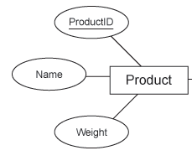
Graphical representation of entities
Entities (i.e. entity-types) are represented as rectangles.
Entity attributes are represented as ellipses
Lines connect attributes with the entity they belong to
Double ellipses represent composite attributes
Attribute identifier is underlined.
18

Slide 19
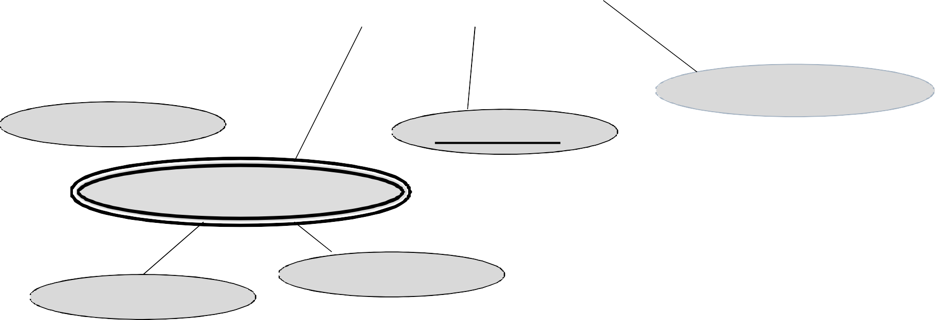
Example
□ Student (id_student, name, SID, faculty, start_date, address_data (street, city, phone))
STUDENT
name
Start_date
phone
Id_student
Address_data
SID
Street
City
19

Slide 20
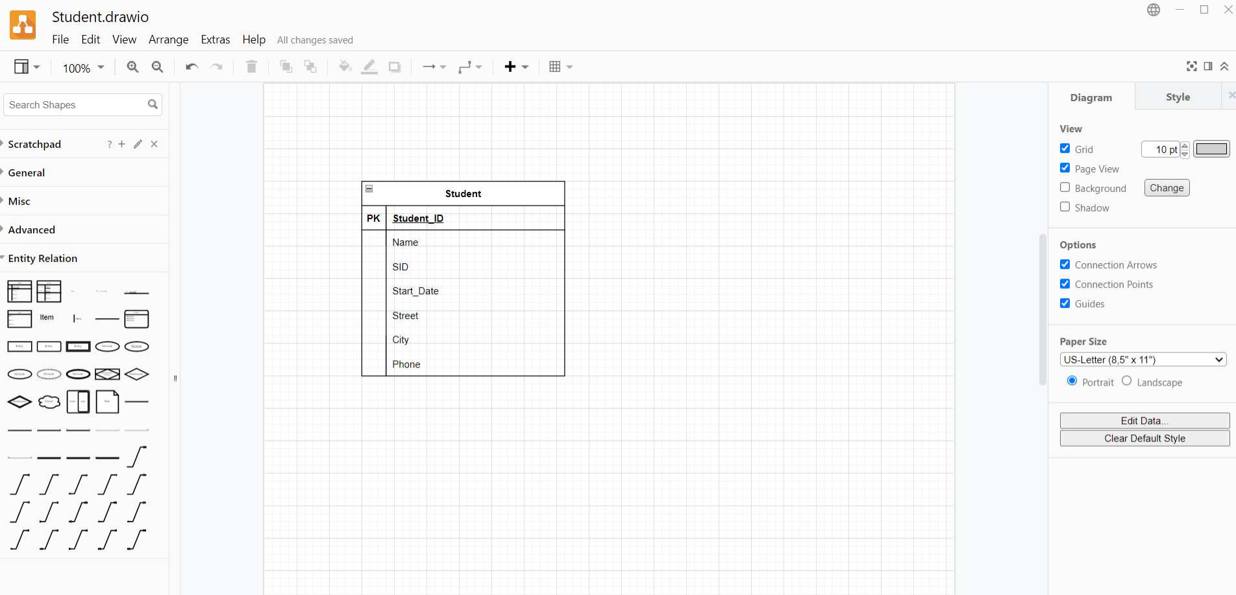
Entities in Draw.io (Diagrams.net)
20

Slide 21
Task. 5 = Homework
□ Make a graphical representation of your entities
□ Deadline: Start of next class
21

